Slide 1
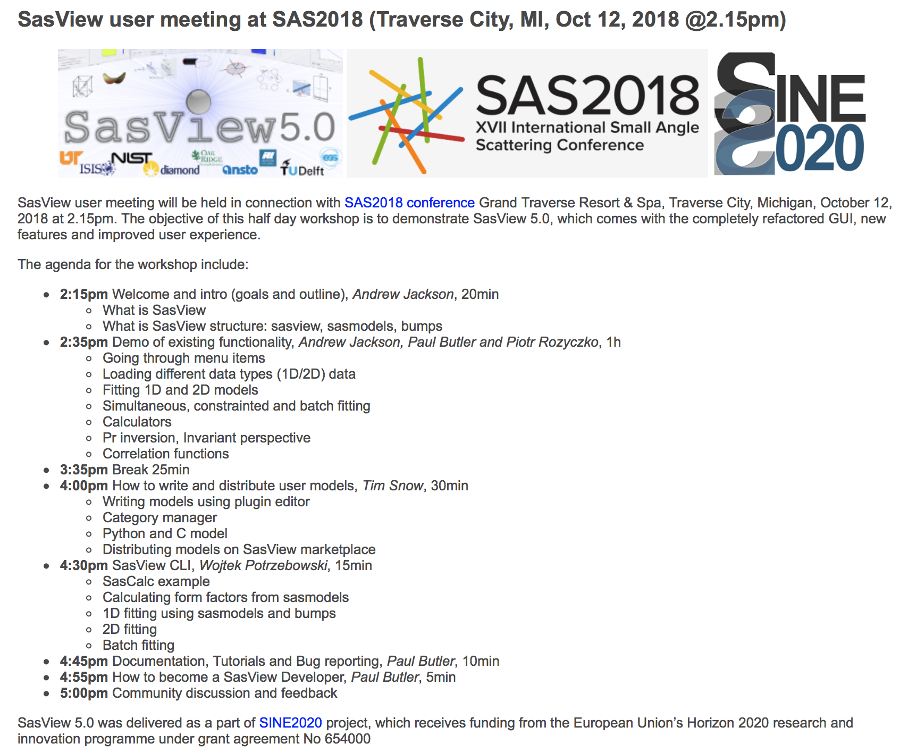

Slide 2





SasView : A Small Angle Scattering Analysis Software Package
Andrew Jackson, European Spallation Source
on behalf of the SasView Collaboration
SasView User Meeting, Grand Traverse Resort, MI
October 12th 2018

Slide 3
Analysis Software - Who’s Job is it Anyway?
Analysis is where the science is → the USER’S JOB
Scattering is an analysis tool and part of providing the tool should be the necessary software → the FACILITY’S JOB
Data sat on disk is useless to EVERYBODY
We need to work together!

Slide 4




A little history …
2006
Heritage: NIST IGOR macros
SansView is DANSE project output
~ 8.5% of funds were for SANS
2011
2012
NIST Supported initial transition from NSF funding
2013
Transition to Community project.
1st Code Camp at NIST April 2013
2014
2nd Code Camp at ISIS April 2014
2015
Move to GitHub
v3.0 released
3rd Code Camp at ESS Feb 2015
Rename to SasView
v3.1 released
2016
4th Code Camp at TU Delft March 2016
v4.0 released
5th Code Camp at ORNL Oct 2016
2017
v4.1 released
6th Code Camp at ILL/ESRF April 2017
7th Code Camp at DMSC October 2017
2018
v4.2 released
8th Code Camp at ESS Sept 2018
v5.0b1 released
1st SasView User Meeting at SAS2018

Slide 5
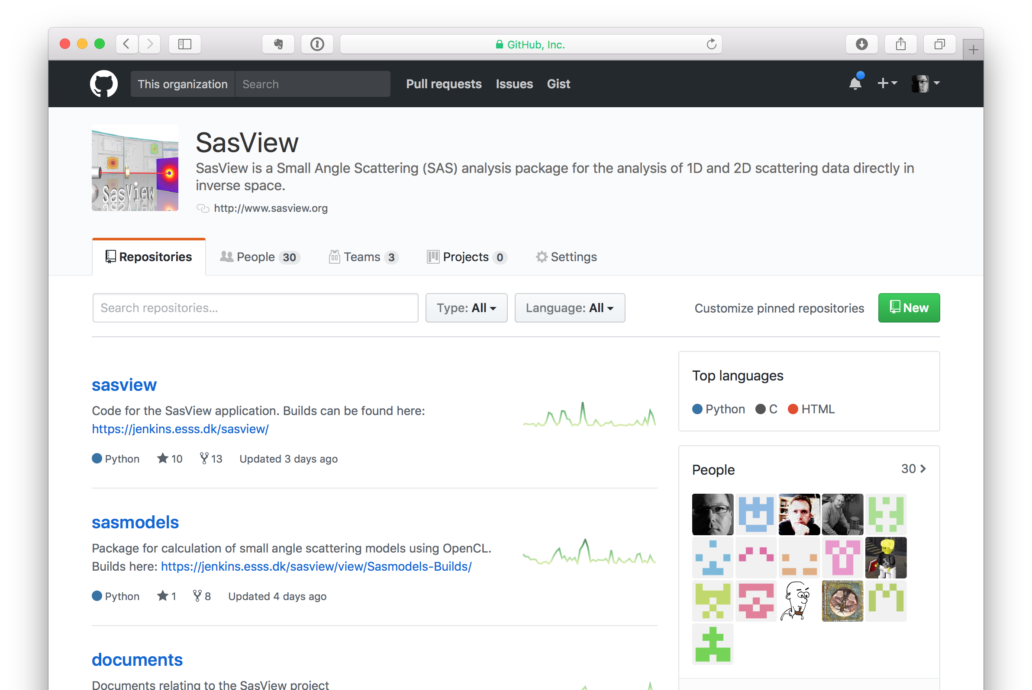
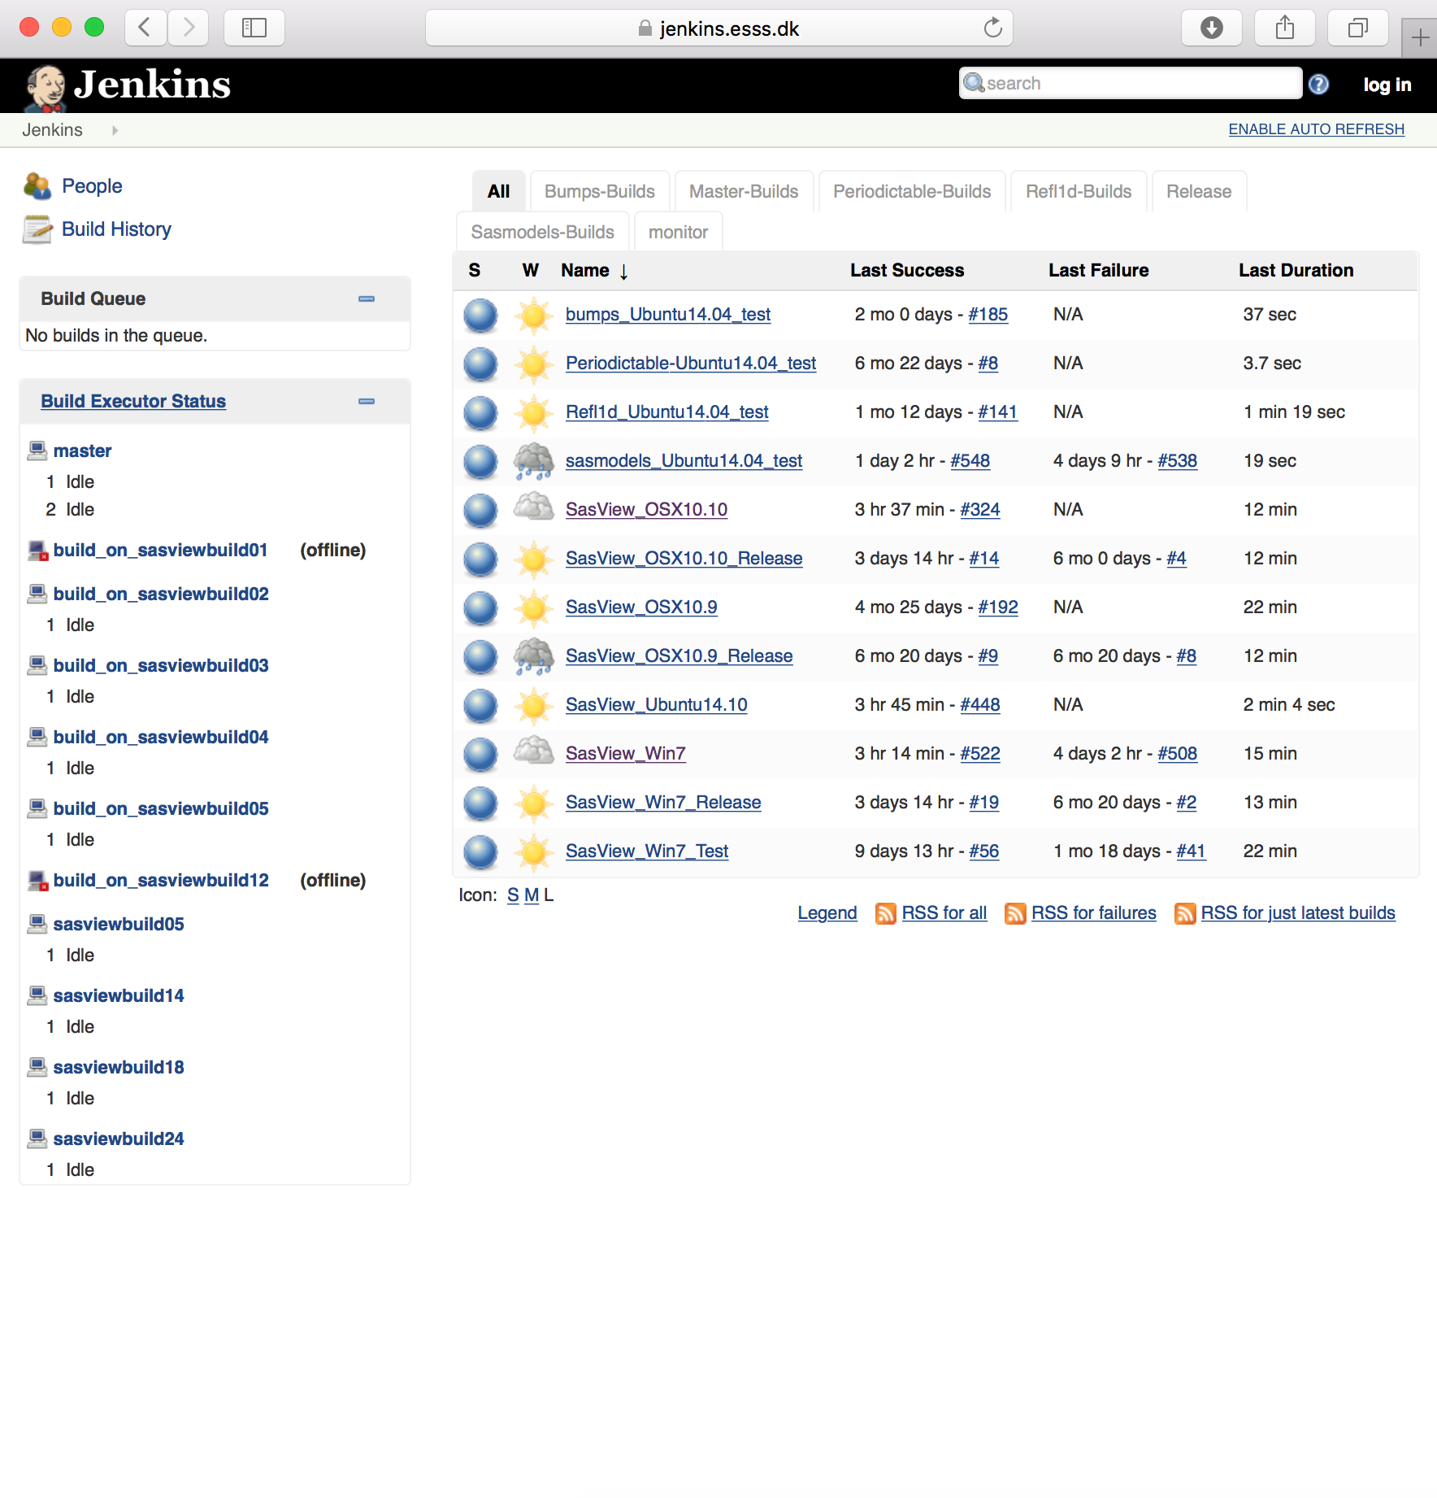
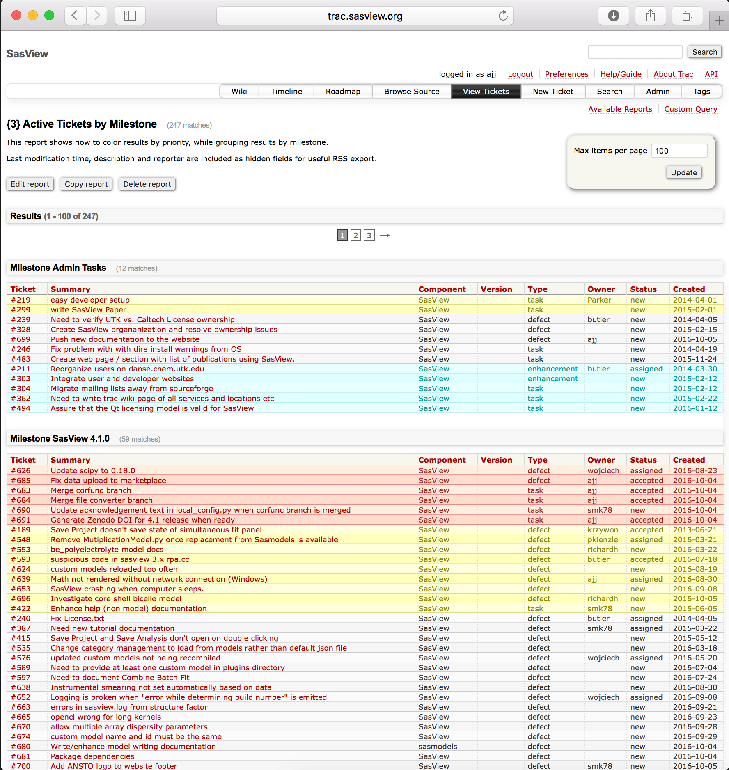
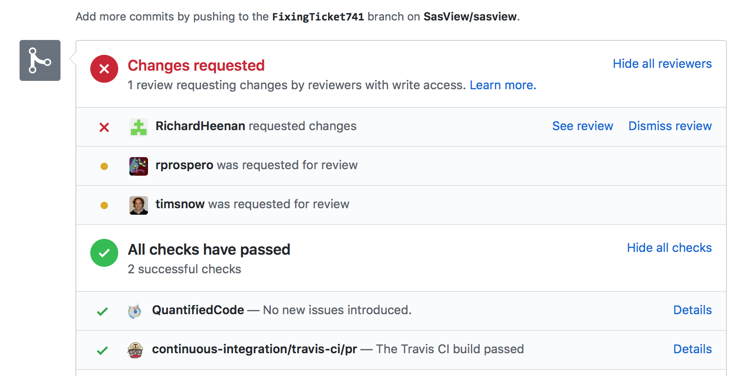
Development Model
Open, Collaborative, Community Development
Code is open source and publicly hosted at Github
Released under BSD 3-clause license
Bug and Enhancement Ticket System (Trac)
Bi-weekly developer calls
Code Camps
5 Year Roadmap
Model Marketplace
Task and bug tracking. Developer wiki
trac.sasview.org
Code Hosting and some CI/testing of PRs
Automated Builds
build.sasview.org
http://www.sasview.org
http://github.com/SasView

Slide 6
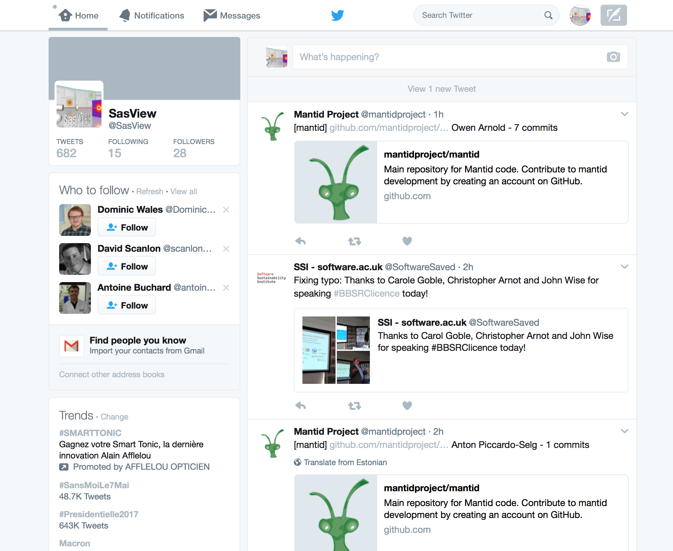
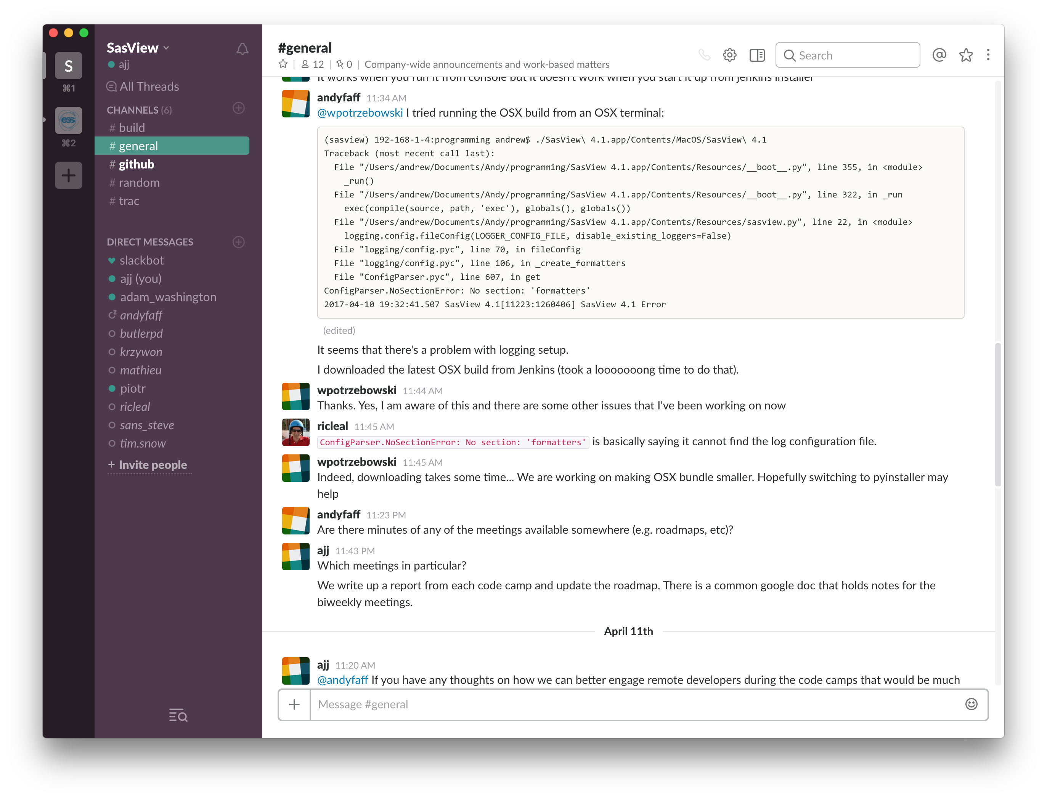
Development Model
Communications
Mailing lists
management@sasview.org
help@sasview.org
developers@sasview.org
users@sasview.org

Slide 7
Development Model
Code Structure
SasView
SasGui
SasCalc
SasModels
Bumps
Scattering models
OpenCL support
Available from pypi
Optimizer with Bayesian uncertainty analysis
Available from pypi
P. Kienzle

Slide 8
SasView 4.x series - 4.2 is out now!
www.sasview.org
Official Releases available for Windows, Mac, and Debian Linux
Models
New models
New model package (sasmodels)
Separation of models from GUI
Simpler addition of models by users
Speed! GPU and parallel processing
New, consistent approach to orientation distributions for 2D
Correlation Function Analysis
CCP13 corfunc algorithm
Documentation
Enhanced, updated documentation for models.
New Tutorials.
SESANS
Automatic transform of SANS model to P(z)
Plotting and fitting of SESANS data from GUI
Example scripts for fitting SESANS data
Simultaneous fitting of SANS & SESANS
Notes:
4.2 key points:
Orientation distributions
Bug fixes for plugin models
Many other bug fixes – see release notes!

Slide 9
SasView – the Next Generation – 5.x
Parallel release of 4.x and 5.x until 5 series is stable. 5.0 beta-1 release out now for testing!
UI Refactoring (“SasView 5.0”)
Move to QT - current and well supported toolkit
Complete separation of GUI and calculation code
Provision of CLI & updated Python API
Release 5.0
Sasmodels Enhancements
Return F(q) from models
Beta approximation
Coherent sums
Constraints refactor
Multi-GPU support
Inclusion of SasFit models
Target release - 5.0
Target release - 5.1
Target release - 5.0
Integration of McSAS
Implementation of key models from Scatter
Target release - 5.1
Documentation
Tutorials – written, interactive & video
Manual
And much more!
See Roadmap and Tickets

Slide 10
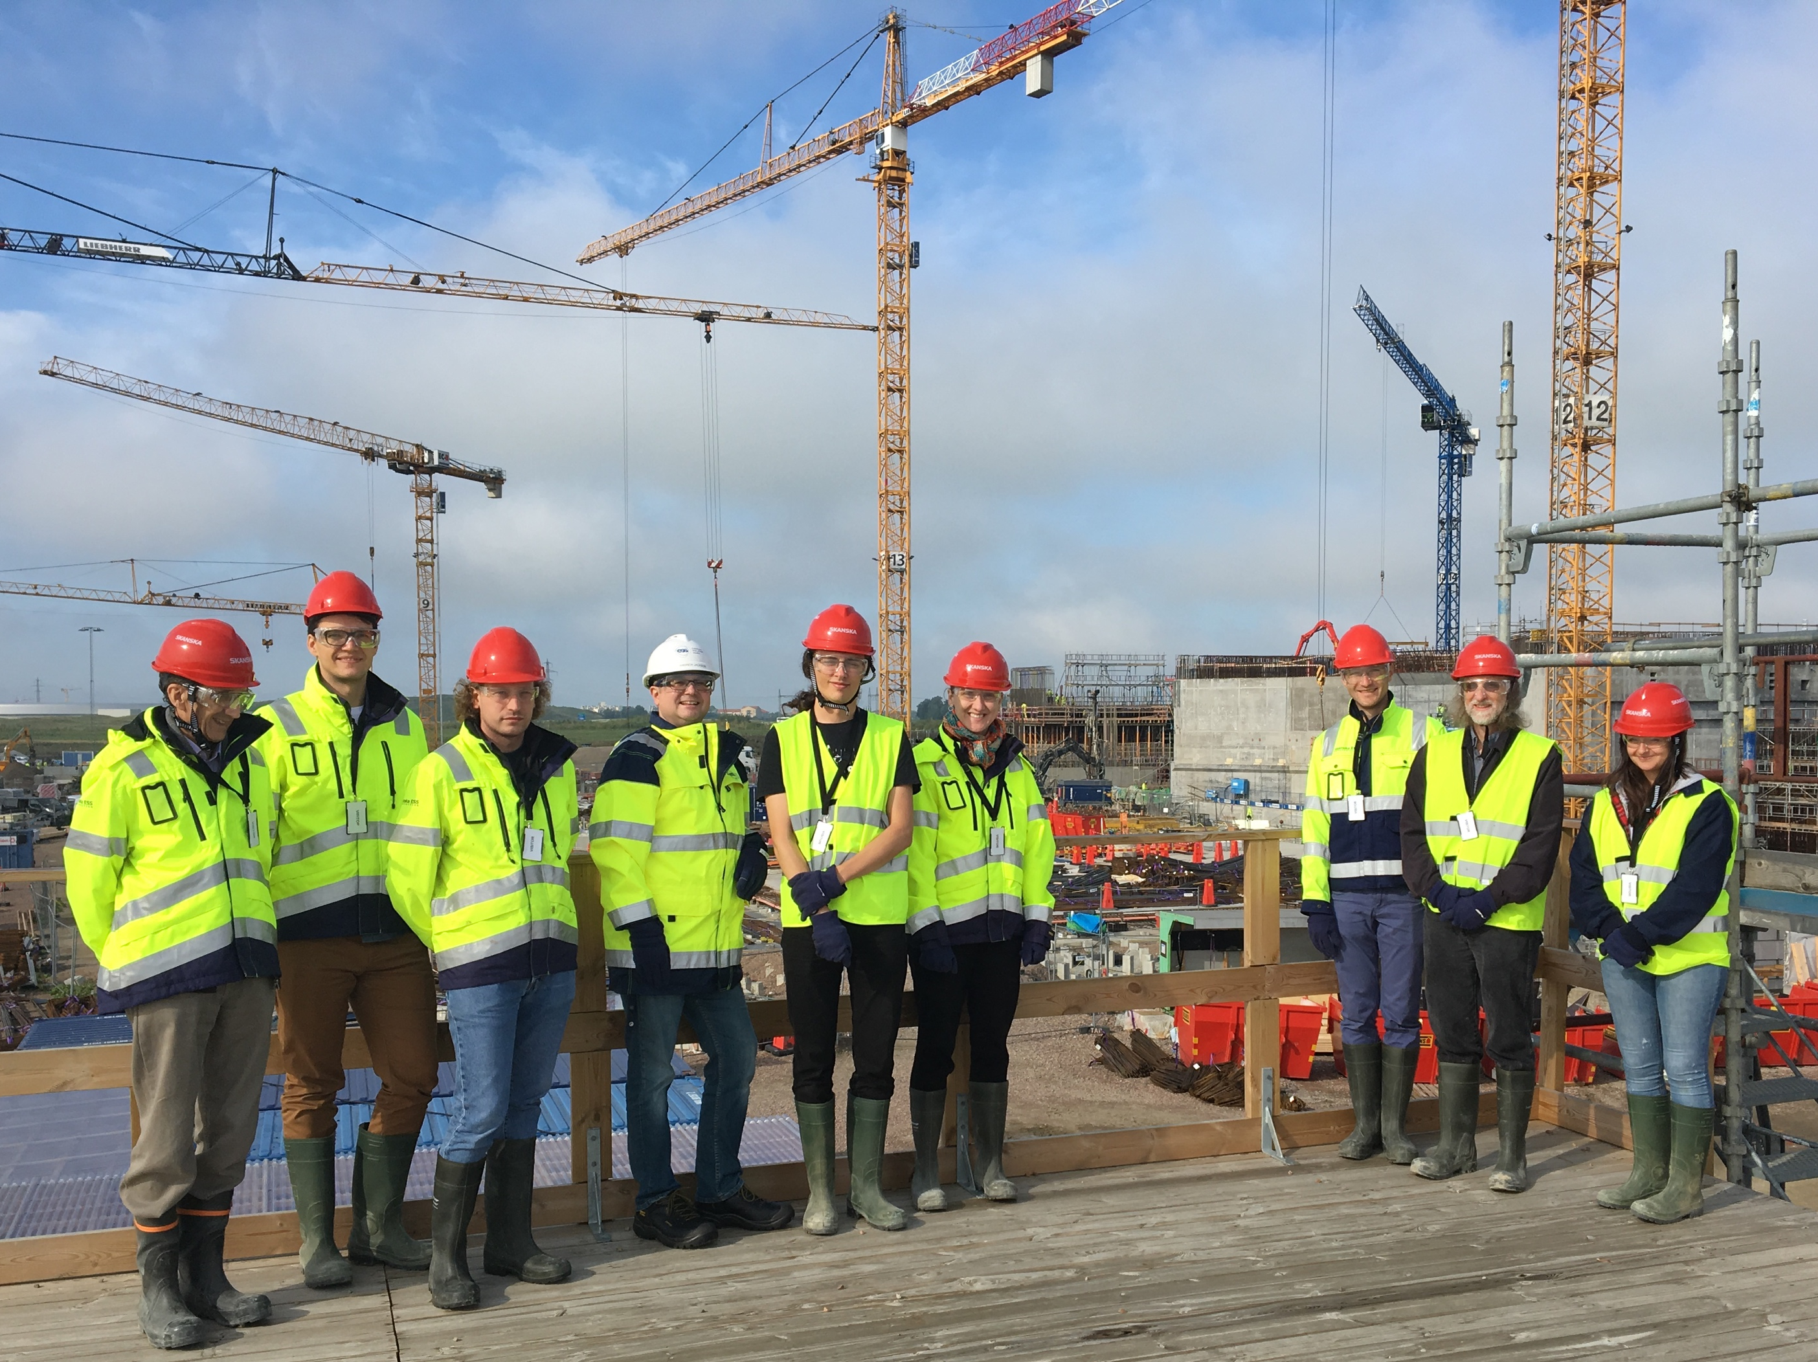
Current Development Team
“Management” Team
Ingo Bressler (BAM)
Torin Cooper-Brennun (STFC)
Laura Forster (Diamond)
Miguel Gonzales (ILL)
Richard Heenan (STFC)
Dirk Honecker (ILL)
Grethe Jensen (NIST)
Paul Kienzle (NIST)
Jeff Kryzwon (NIST)
Ricardo Leal (ORNL)
Torben Nielsen (ESS)
Wojciech Potrzebowski (ESS)
Stuart Prescott (UNSW)
Piotr Rozyczko (ESS)
Tim Snow (Diamond)
Adam Washington (STFC)
Paul Butler (NIST)
Mathieu Doucet (ORNL)
Andrew Jackson (ESS)
Steve King (STFC)
and thanks to the many previous contributors, particularly Jae Hie Cho and Alina Gervaise
Code Camp VIII – ESS, September 2018

Slide 11
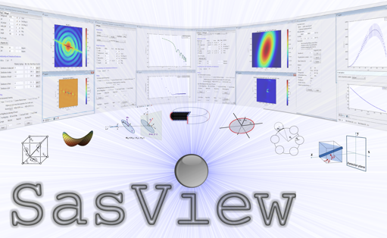
Questions?

Slide 13
What Can SasView Do?

Slide 14
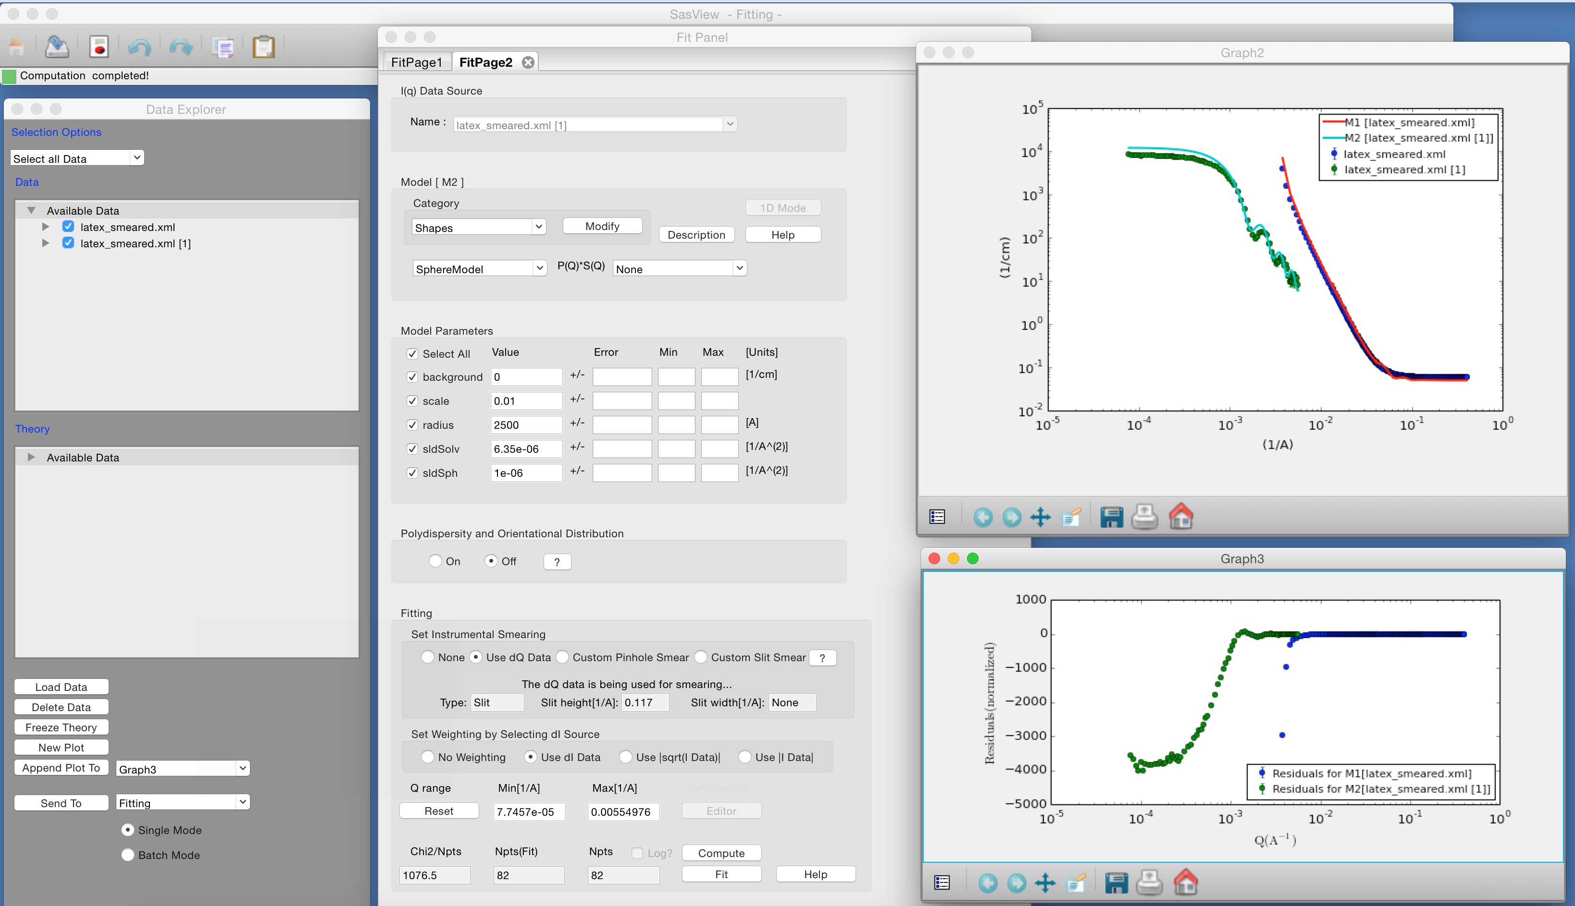
1D Analysis
Data management
Common data formats supported, including NXCansas & cansas1D
Wide choice of built-in models (> 70)
P(Q), S(Q) & P(Q)*S(Q)
Simultaneous fitting
Analysis Tool Choice
&
Plotting
Generic parameter polydispersity
Choice of distribution and distribution parameters
Resolution smearing (pinhole and slit)
Automatically from data or provide parameters

Slide 15
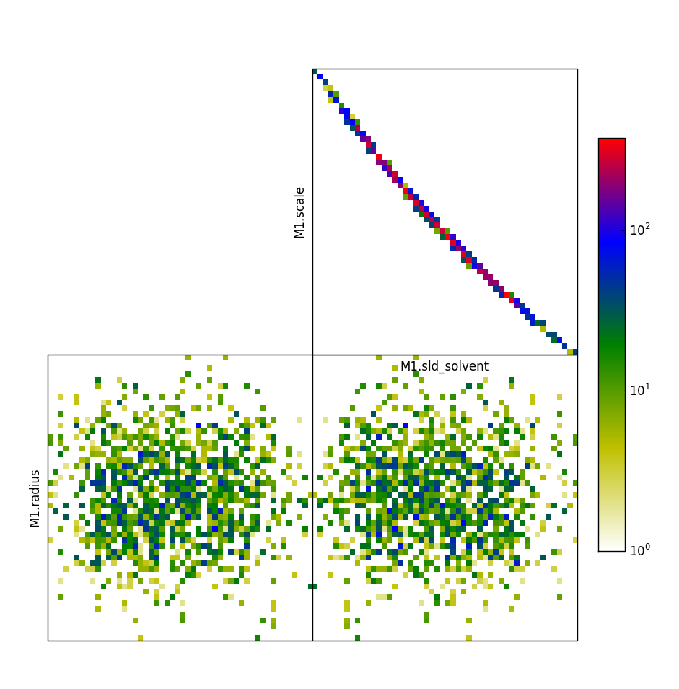
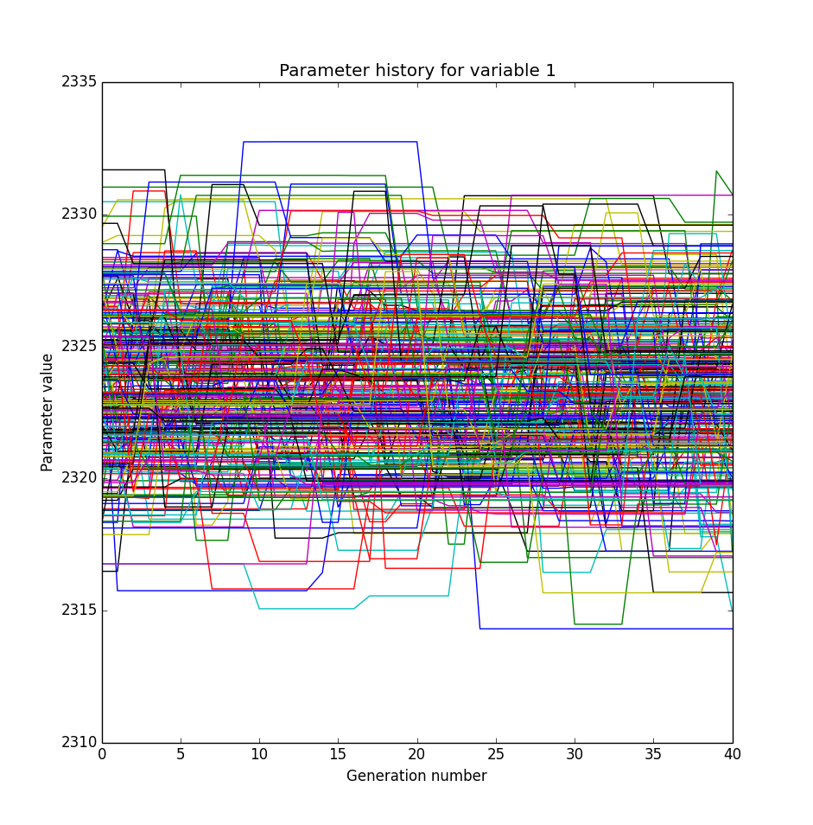
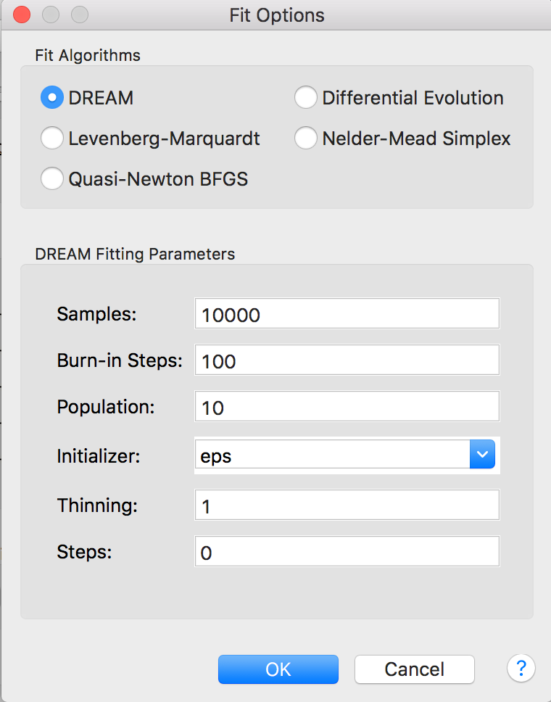
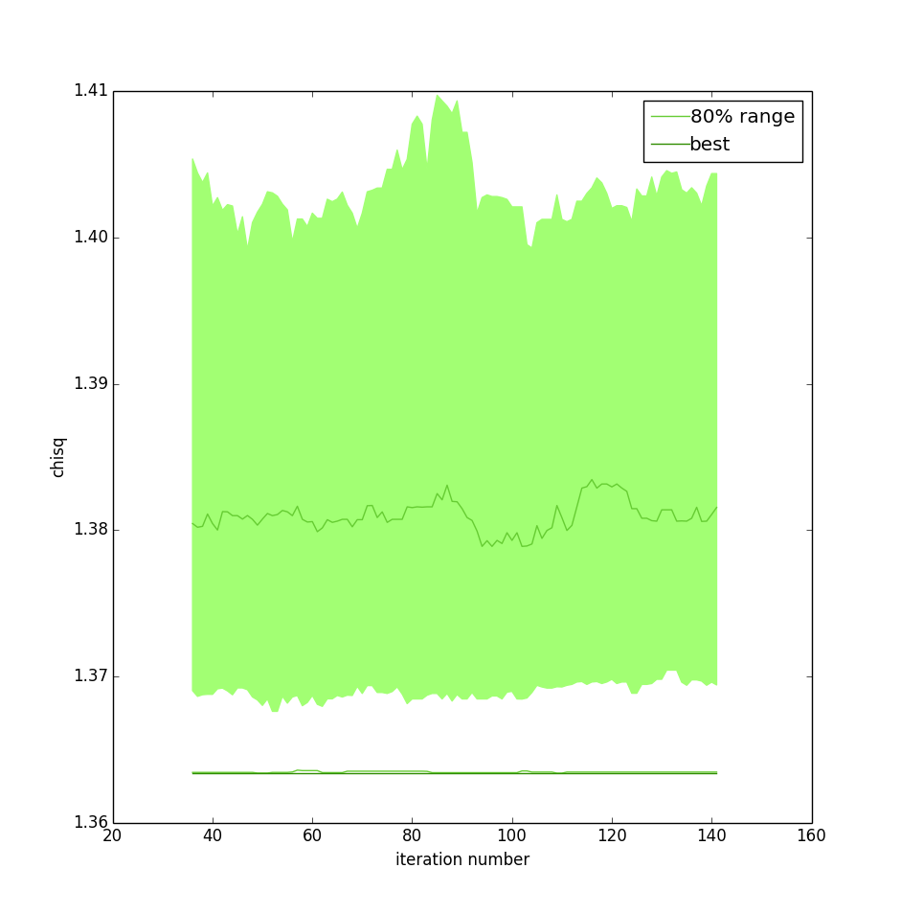
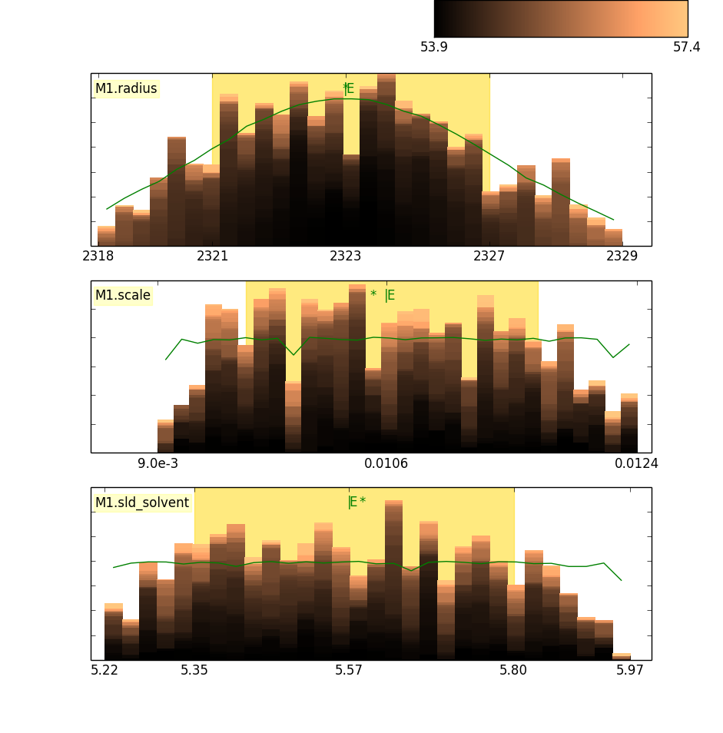
Fitting Algorithms
Uses bumps package from P. Kienzle

Slide 16
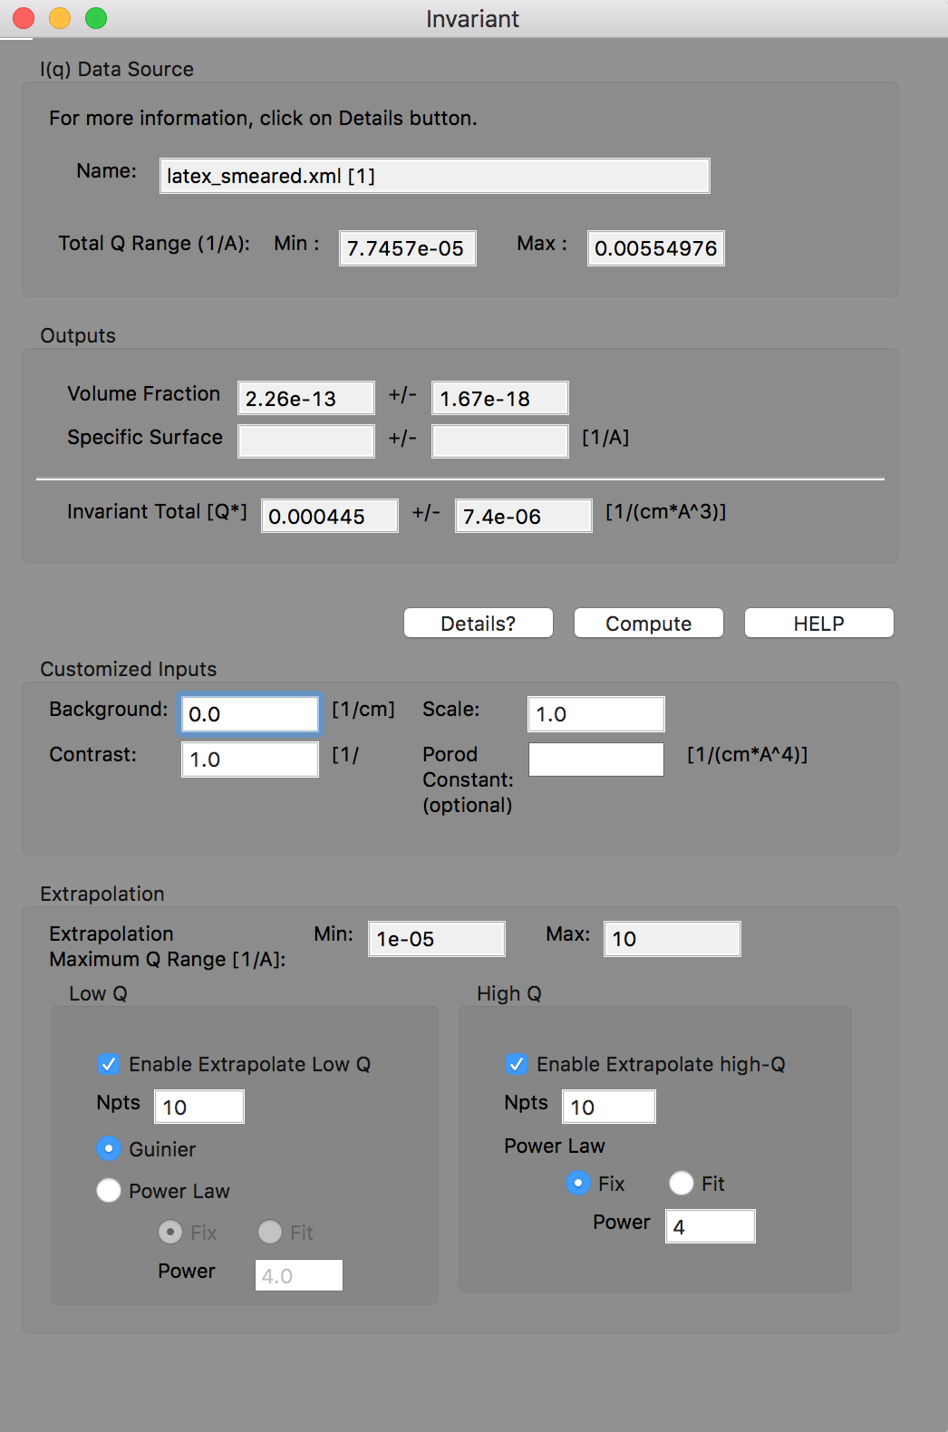
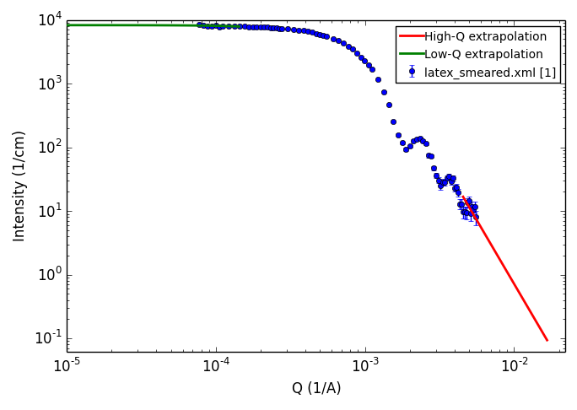
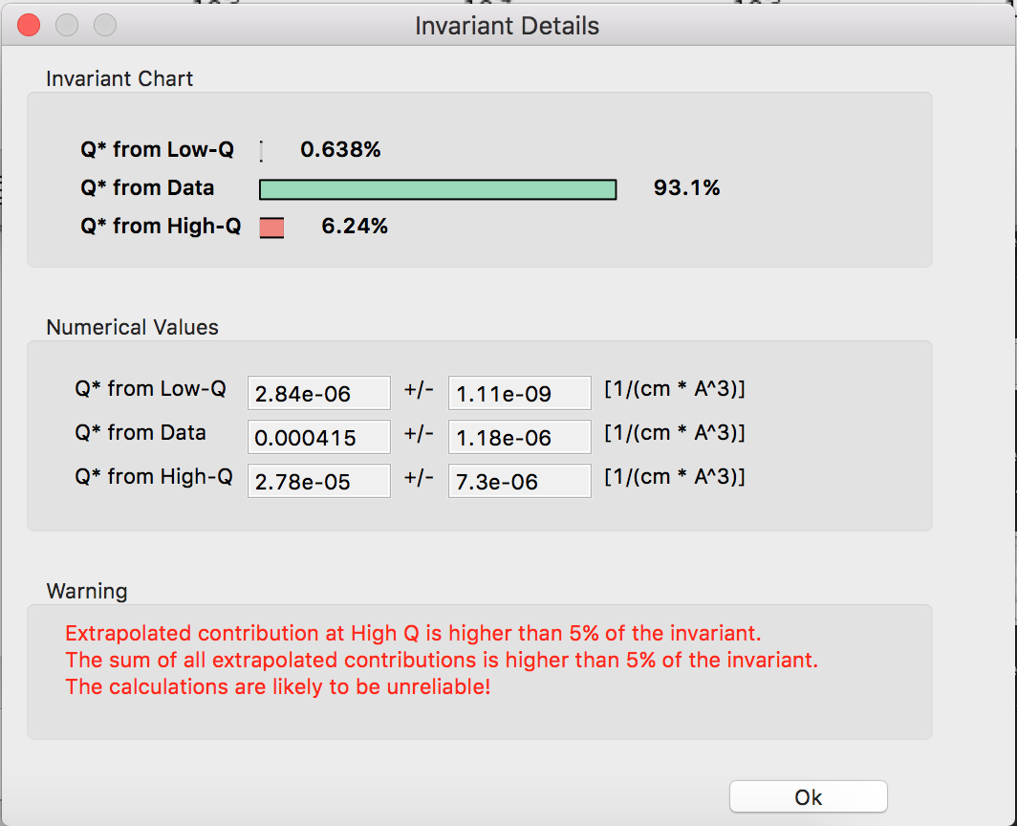
Invariant Calculation

Slide 17
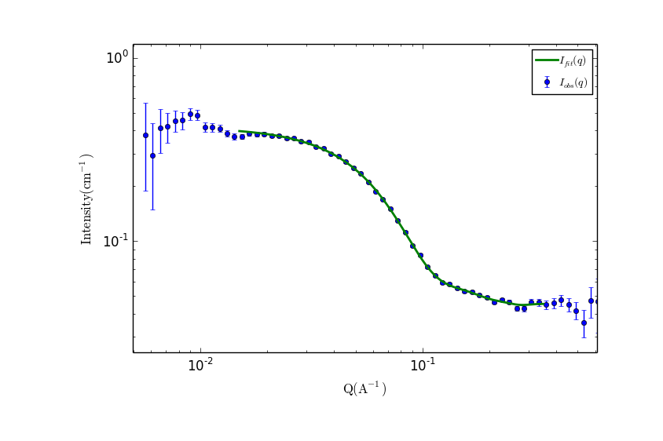
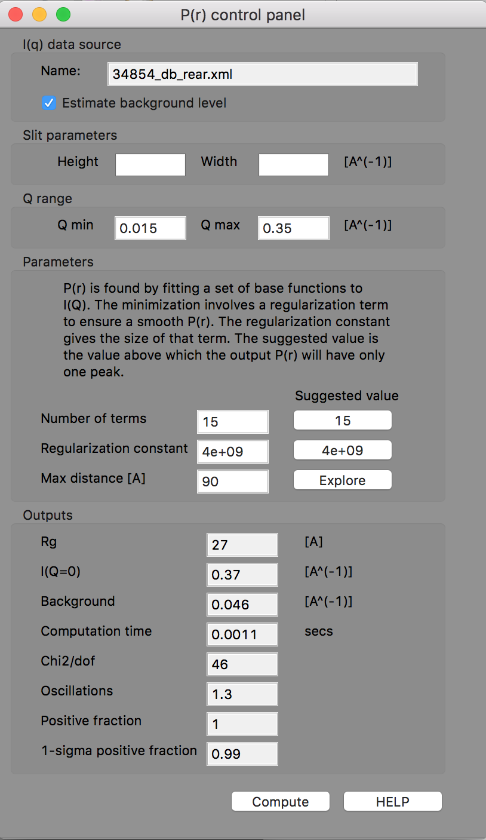
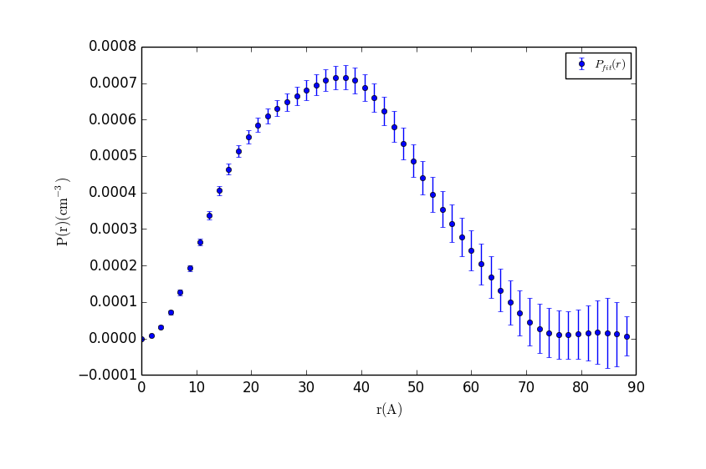
P(r) Inversion

Slide 18
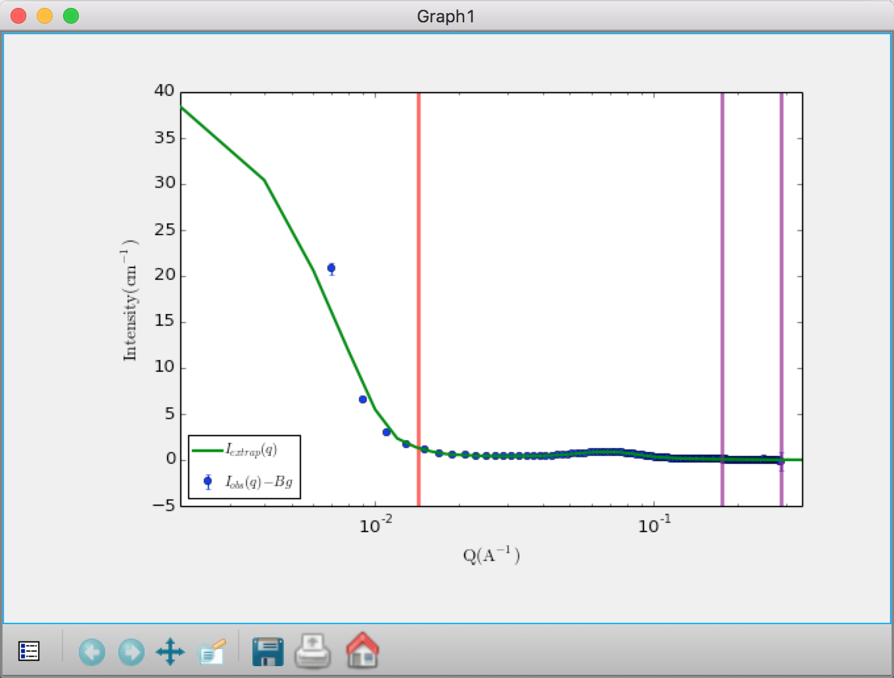
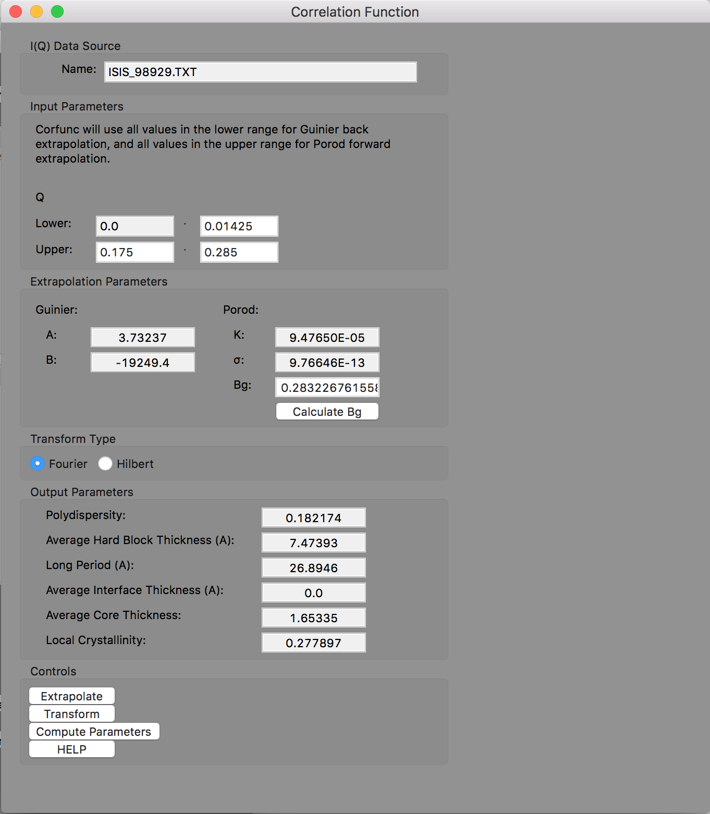
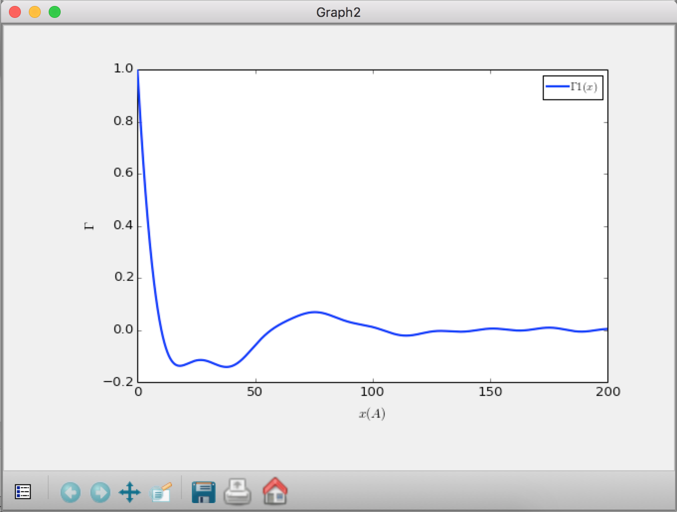
Correlation Function Analysis (new!)

Slide 19
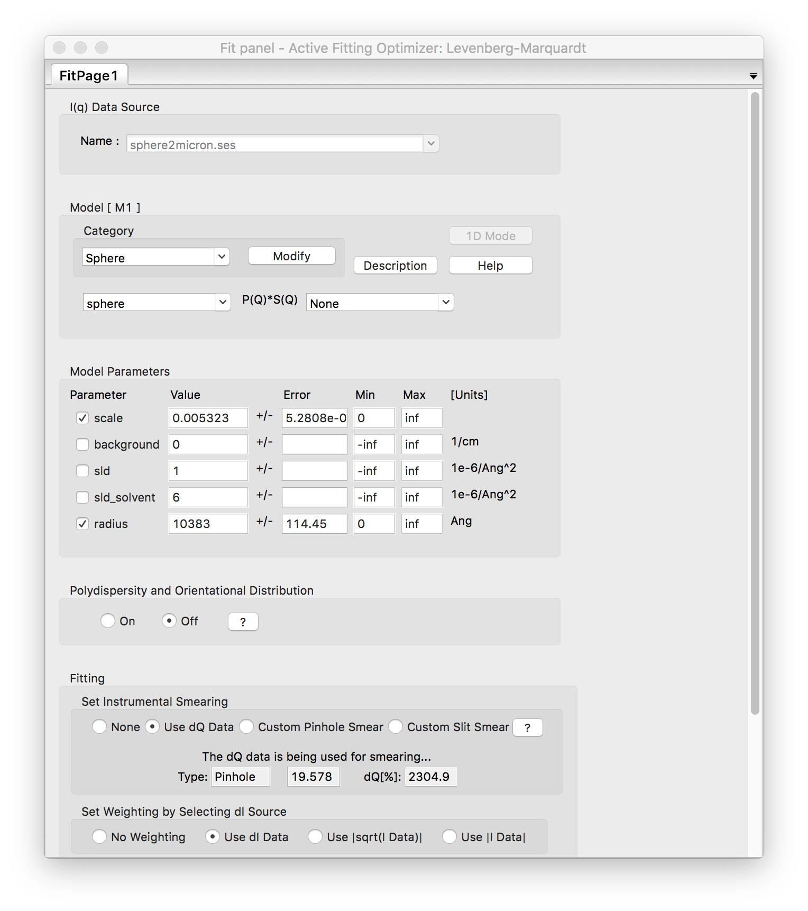
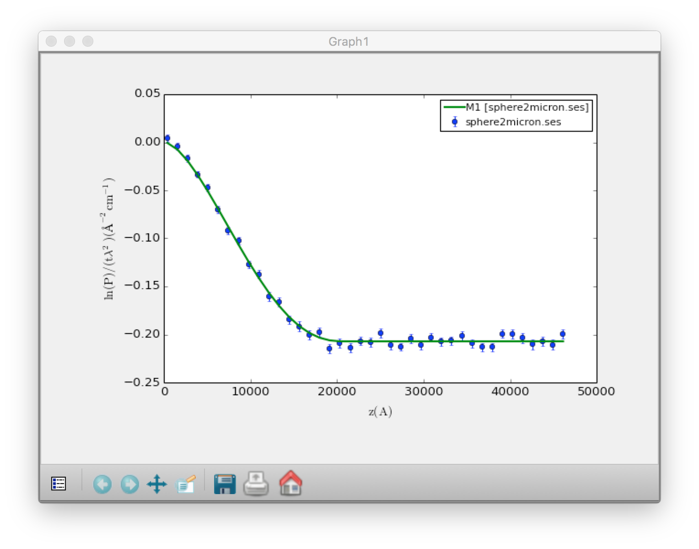
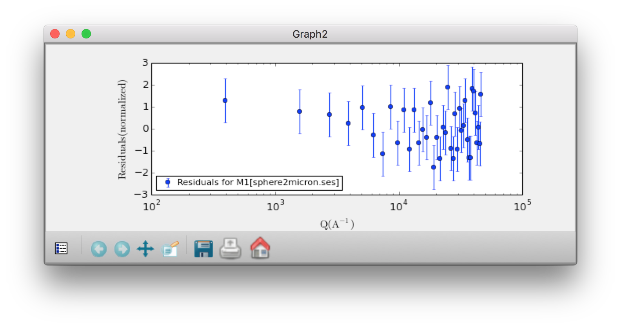
SESANS Analysis
Automatic Hankel Transform of SANS models

